Slide 1

BookMe
Josh Lohner, Seth Beesley, Prosper Jibunor
1

Slide 2
Test Coverage & Burndown Rate (Overall)
Features Completed: 29 of 36 (81%)
Tests Coverage: 100%
6

Slide 3
Test Coverage & Burndown Rate (Overall)
Seth: 14 of 14 Features Completed.
Josh: 12 of 12 Features Completed.
5 of 5 Tests Completed
Prosper: 3 of 10 Features Completed.
6

Slide 4
Final LoC
1645 Lines of Code

Slide 5
Requirements
Landing Page
Login Page / Register Page
Account Creation & Verification
Contact Page
2

Slide 6
Requirements
Nav Bar
List of Contacts
Contact CRUD
Contact Page
2

Slide 7
Requirements
Messaging Page
Message History
Send & Receive Messages
Custom Appointment Objects
2

Slide 8
Requirements
Appointment CRUD
Calendar Creation
2

Slide 9
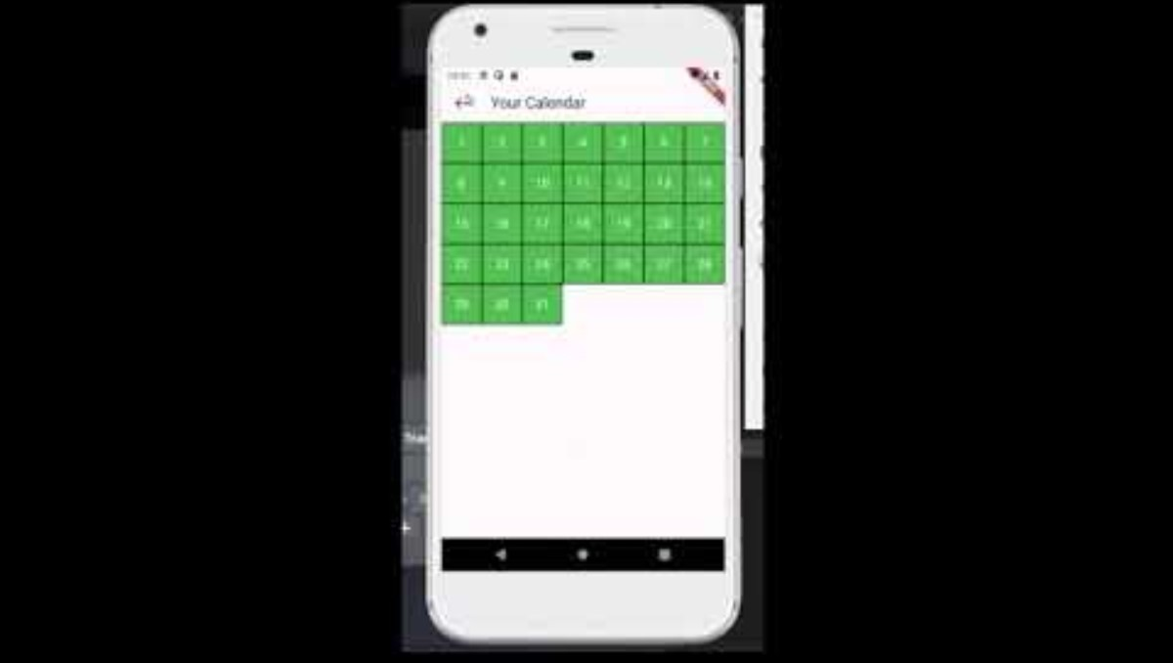
Video Demo
3

Slide 10
What We Learned
When you need help, ask
Work ahead of schedule
Communication is key
Backend & Frontend Implementation
4

Slide 11
Improvements?
Application Beautification
Adding Features like 'real time updates'
Adjusting the app so it's useful for families
5

Slide 12
Test Coverage & Burndown Rate (Overall)
Burndown Rate: 69%
Test Coverage: 30%
7

Slide 13
Challenges
Finals
Individual Projects
8

Slide 14
Current Milestones
Continue to merge the behind-the-scenes technology with user interfaces
9

